Slide 1
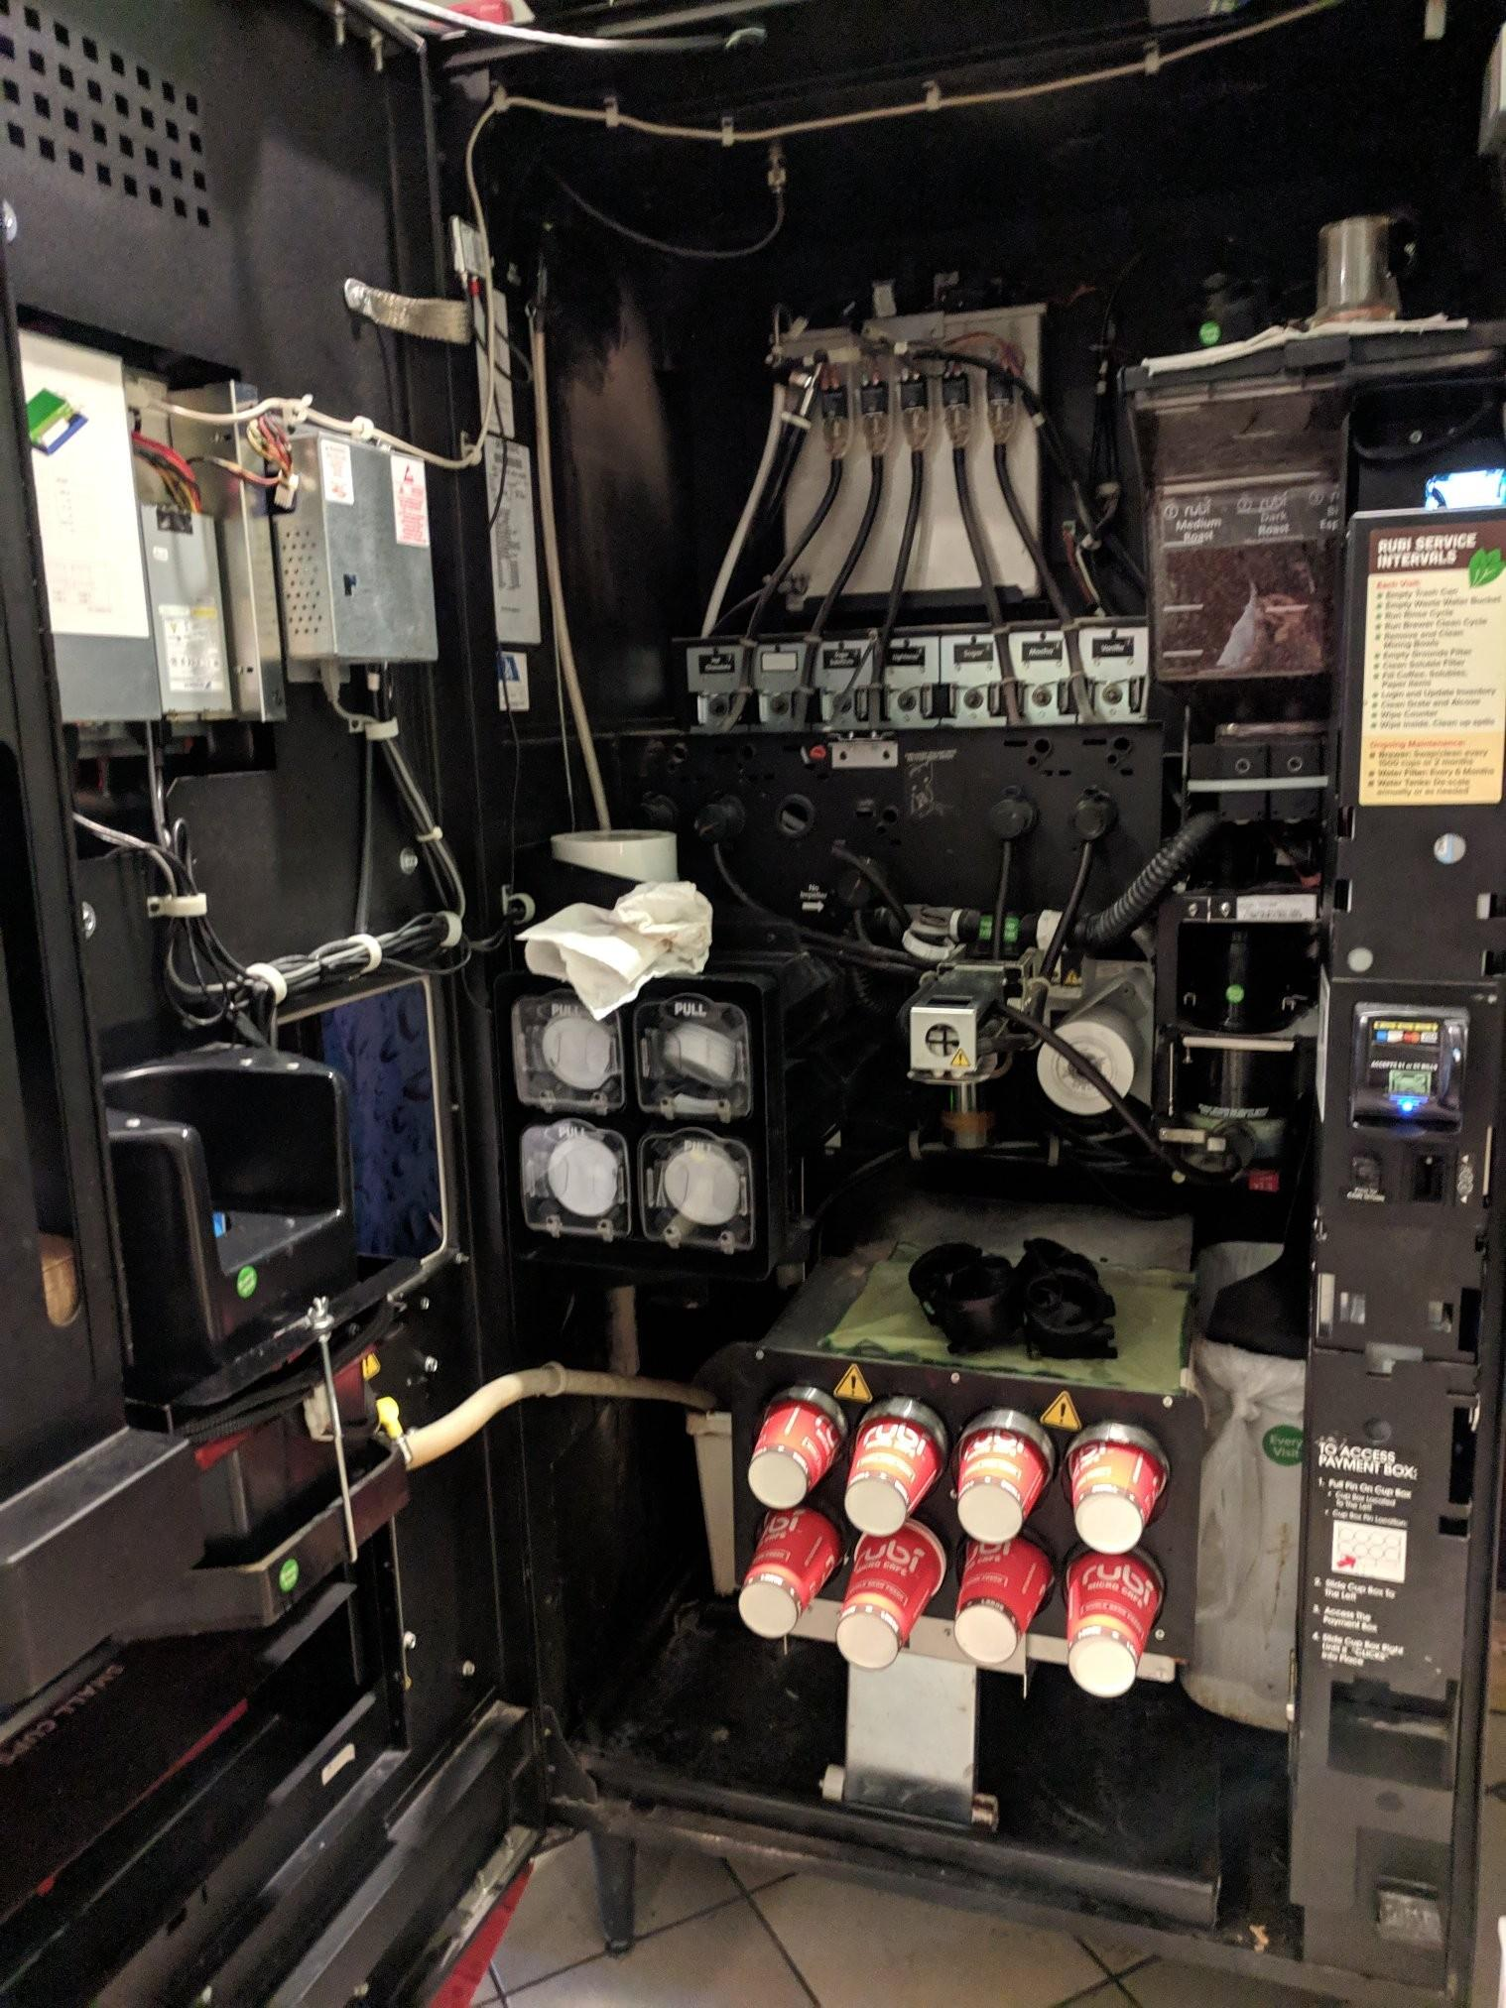
Water Heater
Beans
Flavorings
Flavorings
Coffee Pot
Spout
Trash
Spout

